Slide 1
Introduction to Scrum
01

Slide 2
Software methodologies are concerned with the process of creating software
All methodologies are derived from a logical system problem-solving process that is sometimes called a system development life cycle.
A system development life cycle (SDLC) is a logical process by which systems analysts, software engineers, programmers, and end-users build information systems and computer applications to solve business problems and needs.

Slide 3
What is a Methodology?
A methodology is the physical implementation of the logical life cycle that incorporates
step-by-step activities for each phase,
individual and group roles to be played in each activity,
deliverables and quality standards for each activity, and
tools and techniques to be used for each activity.
A true methodology should encompass the entire system’s development life cycle.
Most modern methodologies incorporate the use of several development tools and techniques.

Slide 4
Why Do Companies use Methodologies?
Methodologies ensure that a consistent, reproducible approach is applied to all projects.
Methodologies reduce the risk associated with shortcuts and mistakes.
Methodologies produce complete and consistent documentation from one project to the next.

Slide 5
S.No | Phase | Activities
1 | Plan | Define system to develop Set the Project Scope Develop the project plan including tasks, resources and time frames
2 | Analysis | Gather the business requirements for the system
3 | Design | Design the technical architecture required to support the system Design system models
4 | Develop | Develop the technical architecture Build the database and the program
5 | Test | Write the test conditions Perform the testing of the system
6 | Implement | Provide the training for the system users Write the detailed user documentation
7 | Maintain | Build a help desk to support the system users Provide and environment to support system changes

Slide 6
Scrum is an Agile Framework.
Its not a methodology

Slide 7
What Is Agile?
Agile Project Management is the process by which the project can be managed and implemented by small chunks of work.
Agile project deliver value to the business in frequent small delivers of product called features

Slide 8
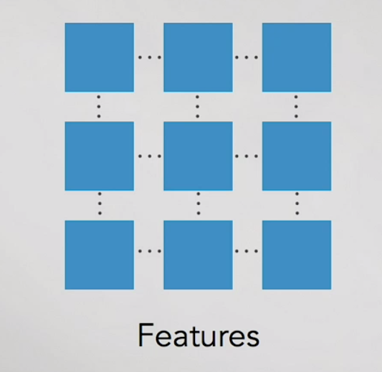

Slide 9
In traditional Water fall methodology the requirements will be documented first
In 2nd step we do the design for the whole solutions will be completed
In 3rd step we do the development
In 4th step we do the testing of the solution developed
And finally the implementation of the product
If this whole process takes whole year to complete , the business does not see any tangible value until very end of the project .

Slide 10
With Agile projects are created with small logical chunks of work called iteration or sprints
Agile is best technique when business needs are frequently changing
Or business wants to receive the product benefits earlier

Slide 11
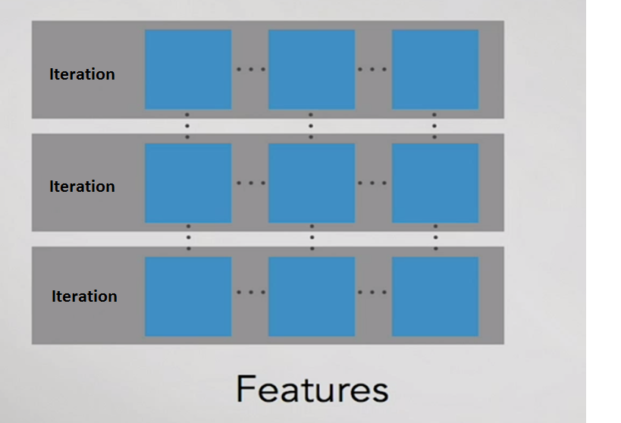

Slide 12
With agile we can focus on what the business needs now
And if it changes , it can be accommodated in the next iteration

Slide 13
Characteristics of Agile Projects
Sprints or Iterations are typically 2 to 4 weeks long
Face to Face communication is emphasised over documentation
We want to produce a product not the product documentation
Business and technical team members are co-located or use very rich virtual tools to simulate being together
Requirements changes are anticipated and accommodated
Communication with all stake holder is critical

Slide 14
Agile Manifesto
A Statement of Values
Individuals and interactions over processes and tools
Working software over comprehensive documentation
Customer collaboration over contract negotiation
Responding to change over following a plan
That is, while there is value in the items on the right, we value the items on the left more.
http://www.agilemanifesto.org

Slide 15
Agile Methods
Scrum
Extreme Programming
Adaptive Software Development (ASD)
Dynamic System Development Method (DSDM)
…
Agile Alliance (www.agilealliance.org) A non-profit organization promotes agile development

Slide 16
So what do we do
We talk more, write less
But write if you have to
Show software to users
Acknowledge that requirements emerge
And all that this implies
Progressively refine our understanding of the product
Express this progressive refinement in the product backlog

Slide 17
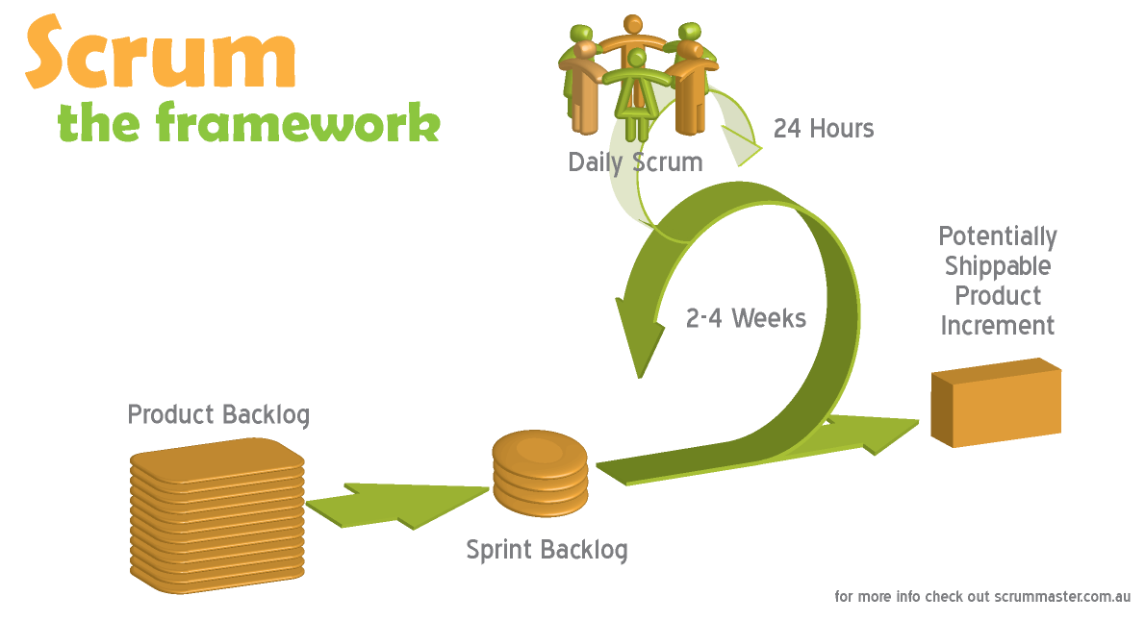

Slide 18
What is Scrum?
Scrum is an agile way to manage a project, usually software development.
Agile software development with Scrum is often perceived as a methodology; but rather than viewing Scrum as methodology, think of it as a framework for managing a process.

Slide 19
In the agile Scrum world, instead of providing complete, detailed descriptions of how everything is to be done on a project, much of it is left up to the Scrum software development team.
This is because the team will know best how to solve the problem they are presented.

Slide 20
This is why in Scrum development, for example, a sprint planning meeting is described in terms of the desired outcome (a commitment to a set of features to be developed in the next sprint) instead of a set of Entry criteria, Task definitions, Validation criteria, and so on, as would be provided in most methodologies.

Slide 21
Scrum relies on a self-organizing, cross-functional team. The Scrum team is self-organizing in that there is no overall team leader who decides which person will do which task or how a problem will be solved. Those are issues that are decided by the team as a whole.
And in Scrum, a team is cross functional, meaning everyone is needed to take a feature from idea to implementation.

Slide 22
Within agile development, Scrum teams are supported by two specific roles. The first is a Scrum Master, who can be thought of as a coach for the team, helping team members use the Scrum process to perform at the highest level.
The Product owner (PO) is the other role, and in Scrum software development, represents the business, customers or users, and guides the team toward building the right product.

Slide 23
Scrum Development: What’s Involved?
The Scrum model suggests that projects progress via a series of sprints. In keeping with an agile methodology, sprints are time boxed to no more than a month long, most commonly two weeks.
Scrum advocates for a planning meeting at the start of the sprint, where team members figure out how many items they can commit to, and then create a sprint backlog – a list of the tasks to perform during the sprint.

Slide 24
During an agile Scrum sprint, the Scrum team takes a small set of features from idea to coded and tested functionality.
At the end, these features are done, meaning coded, tested and integrated into the evolving product or system.

Slide 25
On each day of the sprint, all team members must attend a daily Scrum meeting, including the Scrum Master and Product Owner.
Daily Scrum meeting is time boxed to no more than 15 minutes. During that time, team members share what they worked on the prior day, will work on that day, and identify any impediments to progress.
The Scrum model sees daily Scrums as a way to synchronize the work of team members as they discuss the work of the sprint.

Slide 26
At the end of a sprint, the team conducts a sprint review during which the team demonstrates the new functionality to the PO or any other stakeholder who wishes to provide feedback that could influence the next sprint.
This feedback loop within Scrum software development may result in changes to the freshly delivered functionality, but it may just as likely result in revising or adding items to the product backlog.

Slide 27
Another activity in Scrum project management is the sprint retrospective at the end of each sprint.
The whole team participates in this meeting, including the Scrum Master and PO.
The meeting is an opportunity to reflect on the sprint that has ended, and identify opportunities to improve.

Slide 28
Scrum Process: The Main Artifacts
The primary artifact in Scrum development is, of course, the product itself.
The Scrum model expects the team to bring the product or system to a potentially shippable state at the end of each Scrum sprint.

Slide 29
The product backlog is another artifact of Scrum. This is the complete list of the functionality that remains to be added to the product. The product owner prioritizes the backlog so the team always works on the most valuable features first.
The most popular and successful way to create a product backlog using Scrum methodology is to populate it with user stories, which are short descriptions of functionality described from the perspective of a user or customer
The development team may also add Product Backlog Items for Technical Debt. This represents tasks that are not directly related to features requested by the PO but still need to be delivered.

Slide 30
In Scrum project management, on the first day of a sprint and during the planning meeting, team members create the sprint backlog.
The sprint backlog can be thought of as the team's to-do list for the sprint, whereas a product backlog is a list of features to be built (written in the form of user stories).

Slide 31
The sprint backlog is the list of tasks the team needs to perform in order to deliver the functionality it committed to deliver during the sprint.
Additional artifacts resulting from the Scrum agile methodology is the sprint burndown chart and release burndown chart.
Burndown charts show the amount of work remaining either in a sprint or a release, and are an effective tool in Scrum software development to determine whether a sprint or release is on schedule to have all planned work finished by the desired date.

Slide 32
The Agile Scrum Project: Main Roles
Even if you are new to Scrum, you may have heard of a role called the Scrum Master. The Scrum Master is the team's coach, and helps Scrum practitioners achieve their highest level of performance.
In the Scrum process, a Scrum Master differs from a traditional project manager in many ways, including that this role does not provide day-to-day direction to the team and does not assign tasks to individuals.

Slide 33
A good ScrumMaster shelters the team from outside distractions, allowing team members to focus maniacally during the sprint on the goal they have selected.
While the ScrumMaster focuses on helping the team be the best that it can be, the Product Owner works to direct the team to the right goal.
The product owner does this by creating a compelling vision of the product, and then conveying that vision to the team through the product backlog.

Slide 34
The Product Owner is responsible for prioritizing the backlog during Scrum development, to ensure it’s up to par as more is learned about the system being built, its users, the team and so on.
The third and final role in Scrum project management is the Scrum team itself. Although individuals may join the team with various job titles, in Scrum, those titles are insignificant. Scrum methodology states that each person contributes in whatever way they can to complete the work of each sprint.

Slide 35
“The Scrum team is the car itself, ready to speed along in whatever direction it is pointed. The product owner is the driver, making sure that the car is always going in the right direction. And the ScrumMaster is the chief mechanic, keeping the car well tuned and performing at its best”.

Slide 36
Thank you
QA hopes you enjoyed your course,
as much as we enjoyed teaching you.

